Slide 1
Miscellaneous Topics
Statistics 6740
Lecture 40

Slide 2
Lecture Outline
Questions
Observations on projects
IN=vbl
Other dataset options (DATA, SET, MERGE)
FIRST.vbl and LAST.vbl
Final exam presentation

Slide 3
Notes on Class Projects
Generally pleased with reports
“Data” is plural – synonymous with “numbers”
Incorrect: “Data is,” “data was”
Correct: “Data are,” “data were”
Use PROC FORMAT to get Affluence to display in magnitude order (L-M-H) rather than alphabetical (H-L-M) – county size was naturally ordered the same if you used alphabetical order (L-M-S)
Not many correlated variables across categories
Better way to present summary statistics for all combinations of two categorical variables than huge table ….

Slide 4
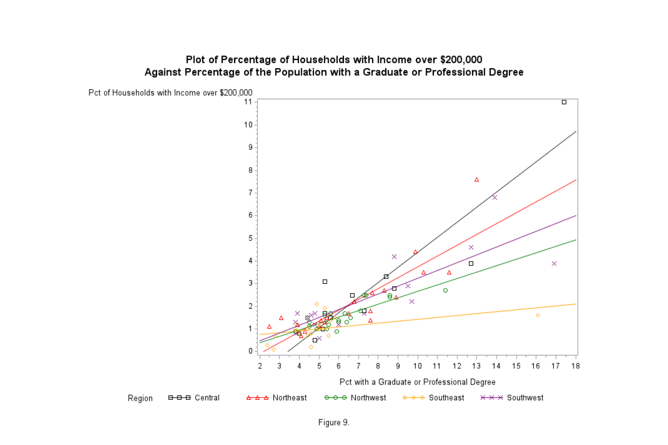
Favorite Graphic from Reports

Slide 5
(IN= ) Dataset Option
You can use a dataset option (IN=variablename) to define a Boolean variable that is 1 for observations from a dataset and 0 for observations that are not from dataset
IN is associated with a dataset
Useful when merging data where there is partial overlap and you want to perform calculations or functions for data from only one of the datasets

Slide 6
(IN = ) Examples
University data:
DATA combine;
MERGE salary (IN=a) attendance (IN=b);
BY fice;
IF a & b;
Blood-lead data;
DATA analysis;
MERGE bll (IN=a) predictors;
BY county tract;
IF A=1;

Slide 7
Dataset Options
DROP=
KEEP=
FIRSTOBS=
LABEL=
OBS=
RENAME=
WHERE=
DATA name (dataset option);
SET name (dataset option);
MERGE name1 (dataset option) name2 (dataset option);

Slide 8
Examples
University data:
DATA revised (RENAME=(num_all=totfac)); SET aaup;
Pct_full = 100*(num_full/num_all);
DATA revised; SET aaup (RENAME=(num_all=totfac));
Pct_full = 100*(num_full/totfac);
Ohio Census tract data:
DATA oh_tracts_2010a (DROP = temp1 temp2);
SET oh_tracts_2010 (RENAME = (county = temp1 tract = temp2));
co_fips = 1.*temp1;
tract = 1.*temp2;
RUN;

Slide 9
FIRST. and LAST.
If you sort dataset, you can read it into a new dataset and use a BY statement. If you do, SAS creates FIRST. and LAST. variables for each variable in the BY statement
The values for FIRST.variablename is 1 for all observations where the variable value changes from the previous observation, and the values for LAST.variablename is 1 for the last observation before the variable value changes
If you have more than 1 variable in the BY statement, a value of 1 appears each time any BY variable changes

Slide 10
Use and Simple Example
Useful if you want to perform functions or calculations that may differ between or change along with a sorting variable
Example: Change in stock prices using LAG function
PROC SORT DATA=saved; BY stock time; RUN;
DATA test; SET saved; BY stock time;
IF FIRST.stock THEN lag_v = .;
ELSE lag_v = LAG(v);
change = v – lag_v;

Slide 11
Another Example – Freezing Grape Vines
PROC NLIN DATA=all2 OUTEST = regparms;
BY location year variety;
PARMS a=-8 b1=-0.15 b2 = 0.01 b3 = 0.2 c1=90 c2=150;
BOUNDS b3 > b2 > b1;
BOUNDS c2 > c1;
IF time <= c1 THEN y = a + b1*time;
ELSE IF time <= c2 THEN y = a + b1*c1 + b2*(time-c1);
ELSE y = a + b1*c1 + b2*(c2-c1) + b3*(time - c2);
MODEL lt50s = y;
RUN;

Slide 12
Example continued
DATA regest regse; SET regparms;
IF _type_ = 'COVB' & _name_ in ('b1', 'b3') THEN OUTPUT regse;
IF _type_ = 'ITER' THEN OUTPUT regest;
RUN;
PROC SORT DATA=regest;
BY location year variety _iter_;
RUN;
DATA regest2; SET regest;
BY location year variety;
IF last.variety;
RUN;

Slide 13
Final Exam
Two datasets from Lake Hartwell PCB study
Seven tasks (5 points each except 1 and 7, (4))
Program naming convention
Program structure instructions
Titles
Footnote
Submit ONLY SAS program to Carmen dropbox

Slide 14
Daily Assignment
Final exam
Complete SEI

